Slide 1


Recognition & Reward Training
DATE
<CLIENT LOGO>
x <COMPANY NAME>
Notes:
Please record the session!

Slide 2
Agenda
Introduction
Program Objectives
Bucketlist App
Bucketlist Demo
Recognition Tips & Best Practices
5 minutes
10 minutes
5 minutes
5 minutes
15 minutes
Notes:
Version 1 that does not include integrations

Slide 3
Agenda
Introduction
Program Objectives
Bucketlist App
Integrations
Bucketlist Demo
Recognition Tips & Best Practices
5 minutes
10 minutes
5 minutes
5 minutes
5 minutes
15 minutes
Notes:
Version 2. that does includes Integrations

Slide 4

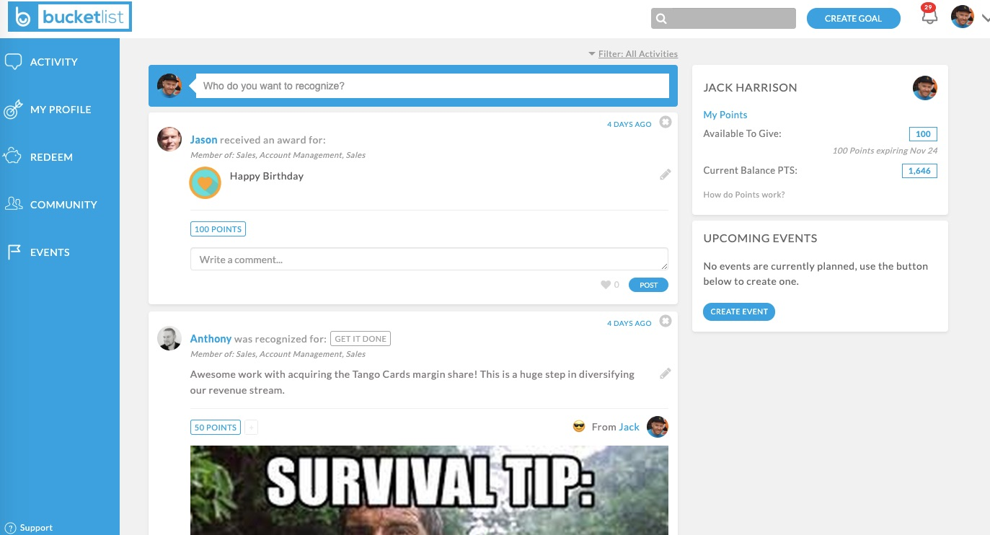
Introduction
What is Bucketlist Rewards?
Easy-to-use platform to recognize your team members in a meaningful way.
Receive points and give out points with recognitions.
Redeem your accumulated points for rewards.
Builds strong company culture through living core values.
Drive a positive work culture
Increase team engagement
“Employees always come first. If you take care of your employees, they will take care of your clients”
SIR Richard Branson

Slide 5






Why is recognition important?
Recognition is a way for a company and its employees to show one another the value of the work and contributions that are being made.
It helps individuals see that their company values them and that their contributions are recognized within the success of the team and overall company.
Additionally, recognition helps motivate people to continue to do great work and enjoy their workplace.

Slide 6
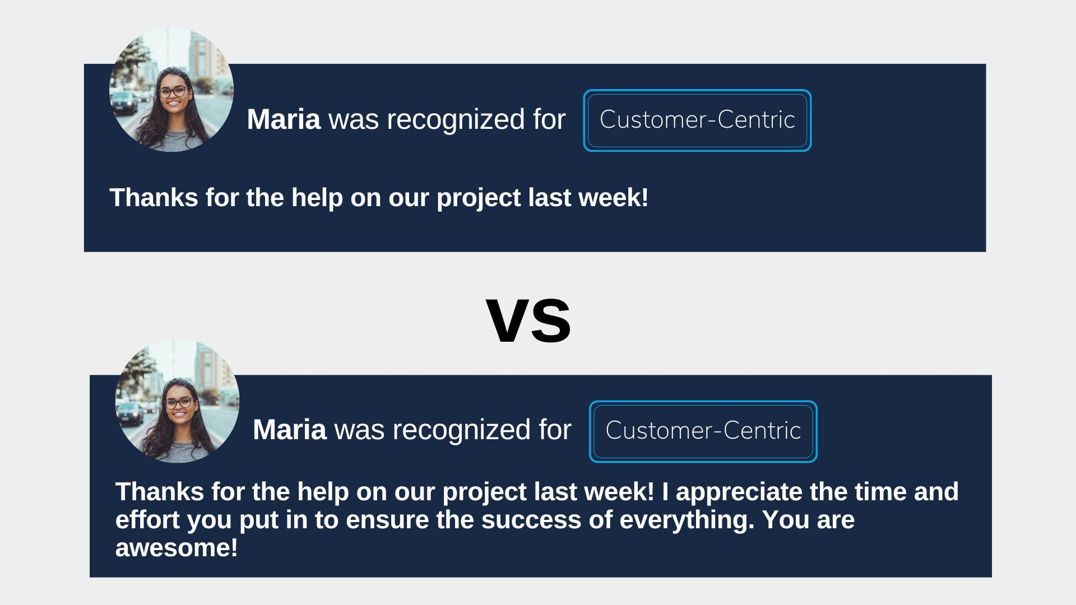
Which recognition would you like to receive?
Notes:
TO BE UPDATED WITH SCREENSHOTS FROM BUCKETLIST DEMO SITE
*NOTE: IF USING THESE SLIDES (MARIA/SAL) DO NOT USE THE BUCKETLIST IN ACTION SLIDES. USE ONE STYLE OR THE OTHER

Slide 7
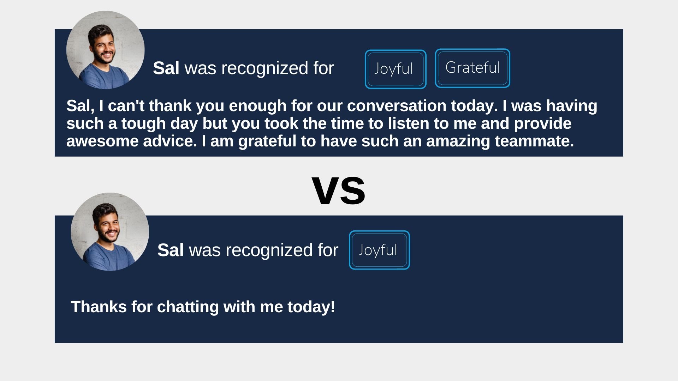
Which recognition would you like to receive?
Notes:
TO BE UPDATED WITH SCREENSHOTS FROM BUCKETLIST DEMO SITE
*NOTE: IF USING THESE SLIDES (MARIA/SAL) DO NOT USE THE BUCKETLIST IN ACTION SLIDES. USE ONE STYLE OR THE OTHER

Slide 8
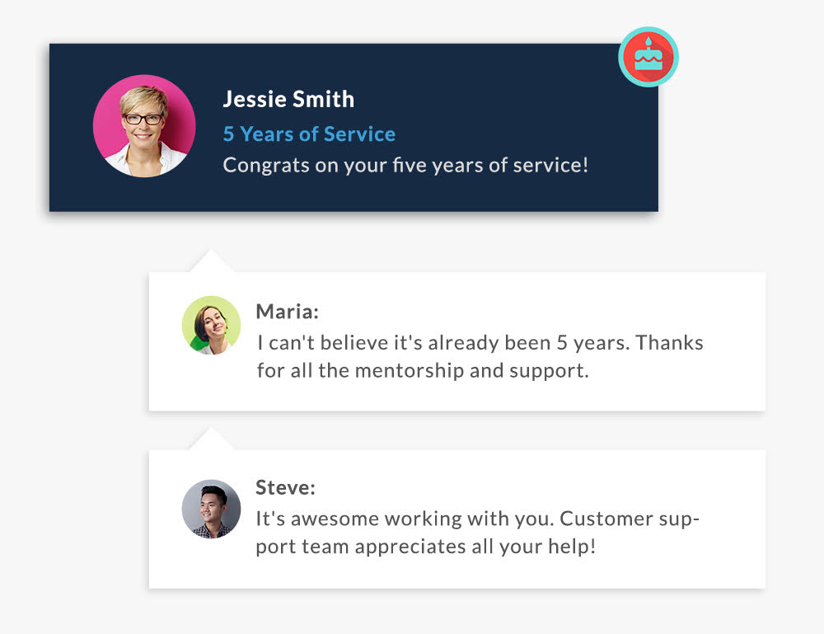
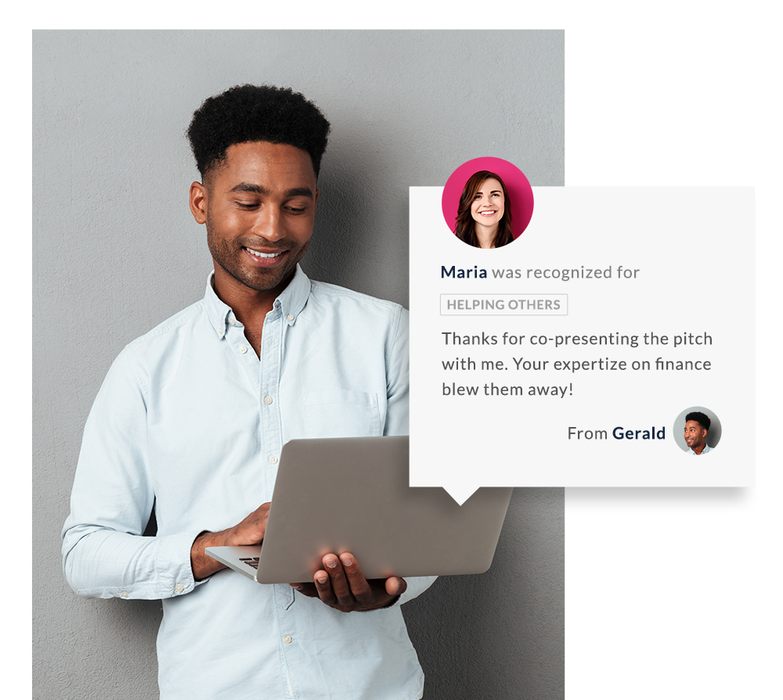
Bucketlist in Action
Notes:
Version 1
Choose one of these slides and not both
* NOTE: IF USING THE MARIA/SAL SLIDES PLEASE DO NOT USE. THIS SLIDE IS BEST USED IF COMPANY IS NOT USING A POINTS SYSTEM AND HAS SERVICE AWARDS *

Slide 9
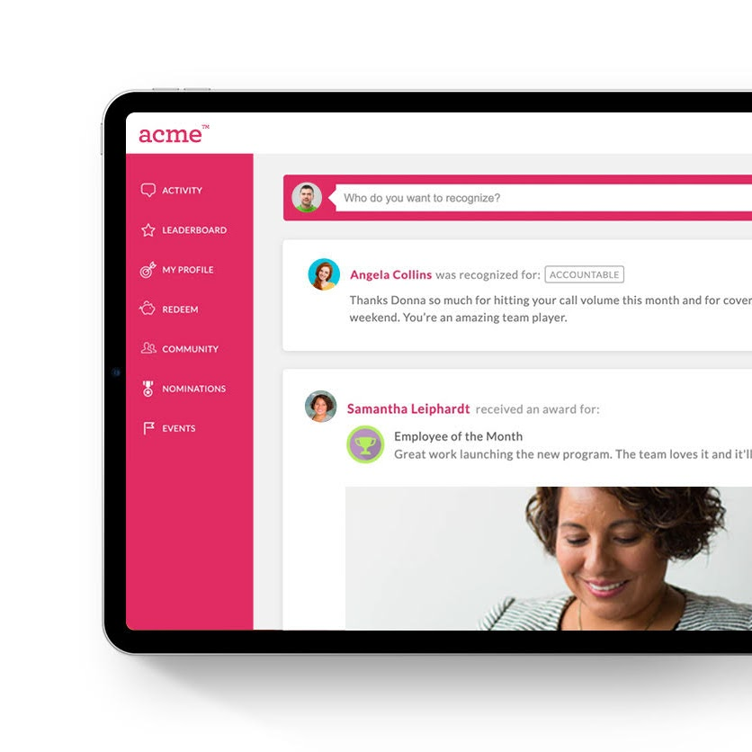
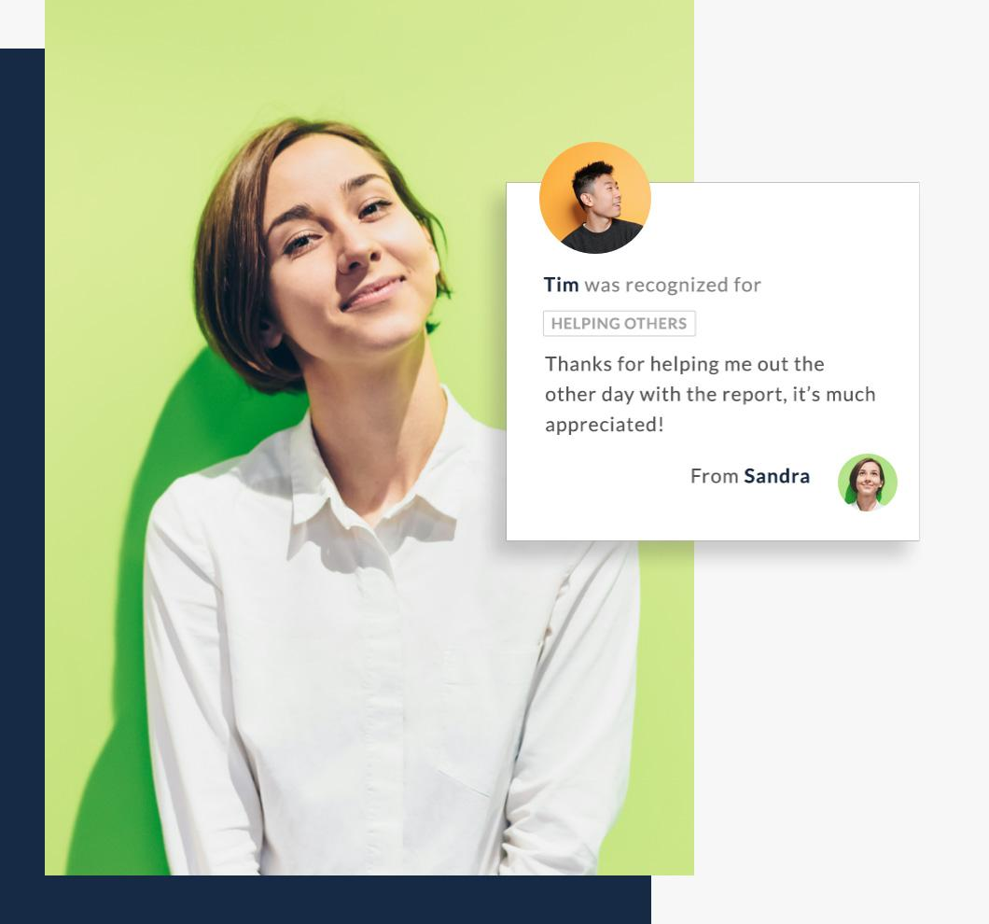
Bucketlist in Action
Notes:
Version 2
Choose one of these slides and not both
* NOTE: IF USING THE MARIA/SAL SLIDES PLEASE DO NOT USE *

Slide 10

What is an Ambassador?
help drive success, engagement, product adoption of the program!
demonstrate the purpose and value of peer-to-peer recognition
YOU
give out recognitions to their peers often
set a good example on how to give out meaningful recognitions
learn how easy it is to use Bucketlist and help your peers with any questions they may have about the platform
Notes:
Ambassador training specific slide. Remove if employee or manager training

Slide 11

Program Objectives Within [COMPANY NAME]
Ease of Use
Keeping Your Best People
Make recognition easy for everyone
Desktop & Mobile App
Improve retention & build recognition into the organization as part of a more positive and uplifting culture
Workplace Connection
Encourage Core Values
INSERT COMPANY VALUES
Get to know your colleagues
Breakdown workplace silos
Celebrate successes & achievements
Notes:
Manager training specific slide

Slide 12
Program Objectives Within [COMPANY NAME]
Ease of Use
Celebrate Successes
Make recognition easy for everyone
Desktop & Mobile App
Foster a more positive environment
Showcase the value of your contributions
Workplace Connection
Encourage Core Values
INSERT COMPANY VALUES
Get to know your colleagues
Breakdown workplace silos
Notes:
Employee/Ambassador training specific slide

Slide 13

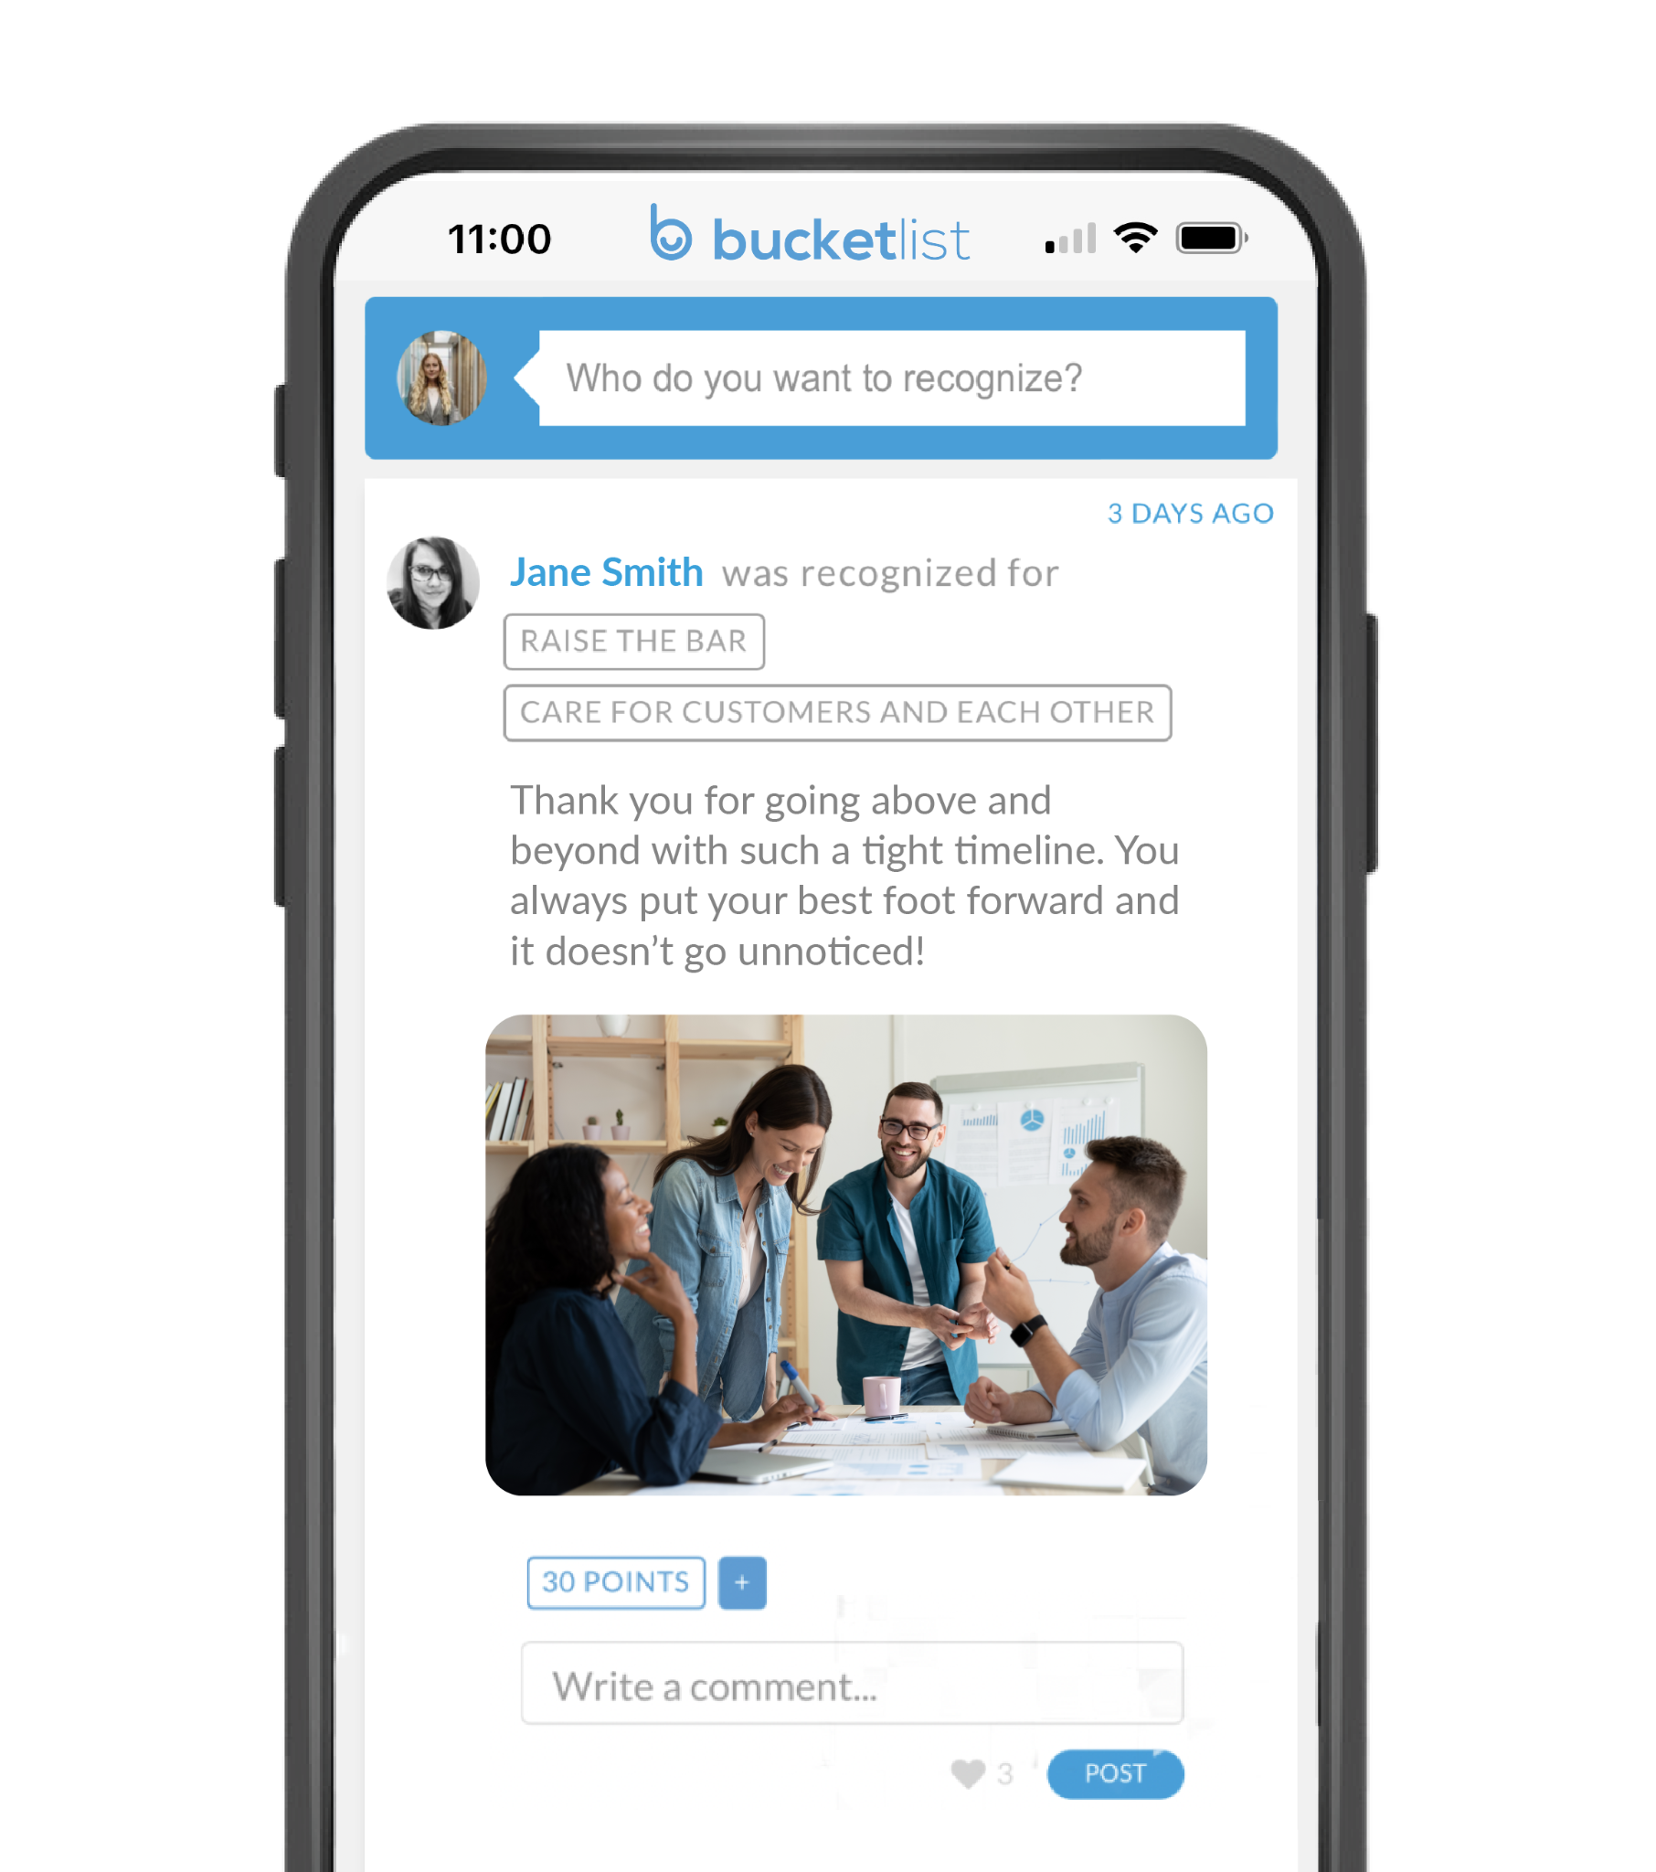


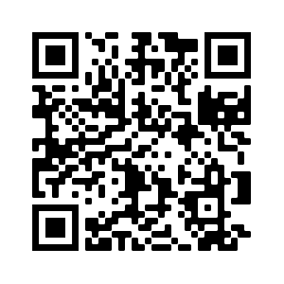
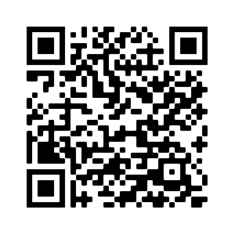
Easy & Convenient
Recognizing staff for outstanding contributions straight from your phone
Like & Comment
Use them thumbs for good!

Slide 14
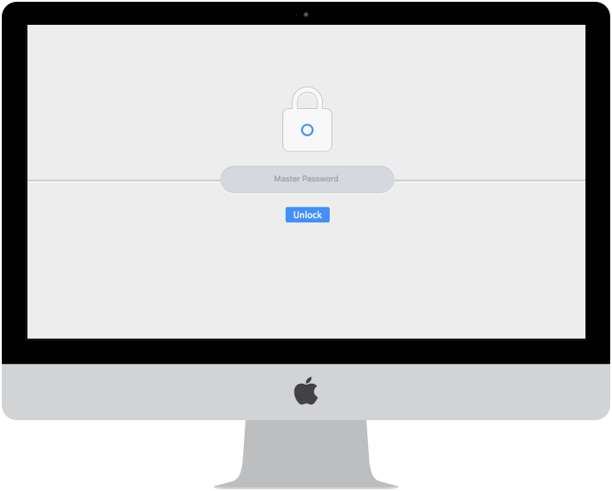
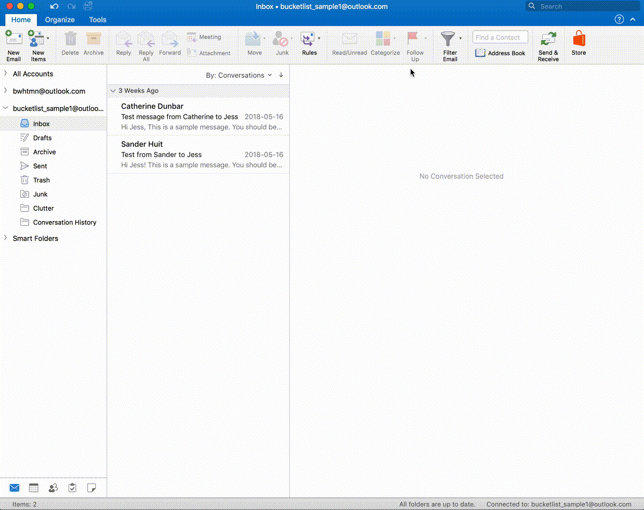
Outlook Integration
It’s really simple and only takes 30 seconds to add it to your Outlook suite!
Notes:
Version 1 of Outlook integration - showcasing IT setup
Pick this one or the one below

Slide 15
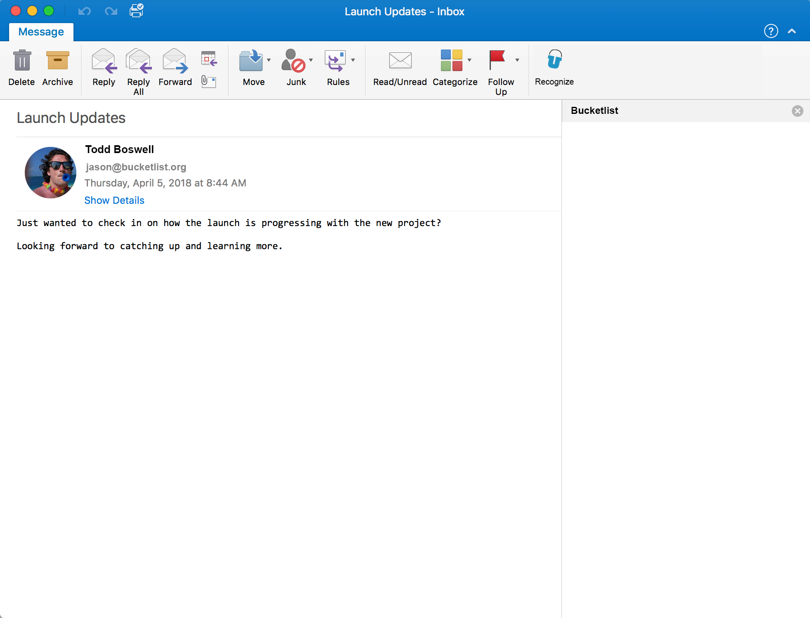
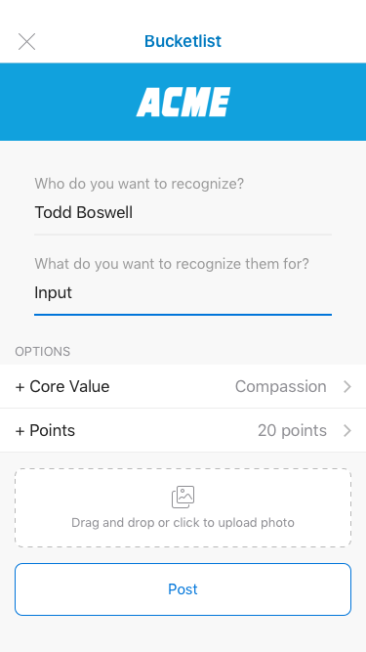
Outlook Integration
We integrate with Outlook making it easy for all employees to recognize one another
Notes:
Version 2 of Outlook integration showcasing an employee set up

Slide 16
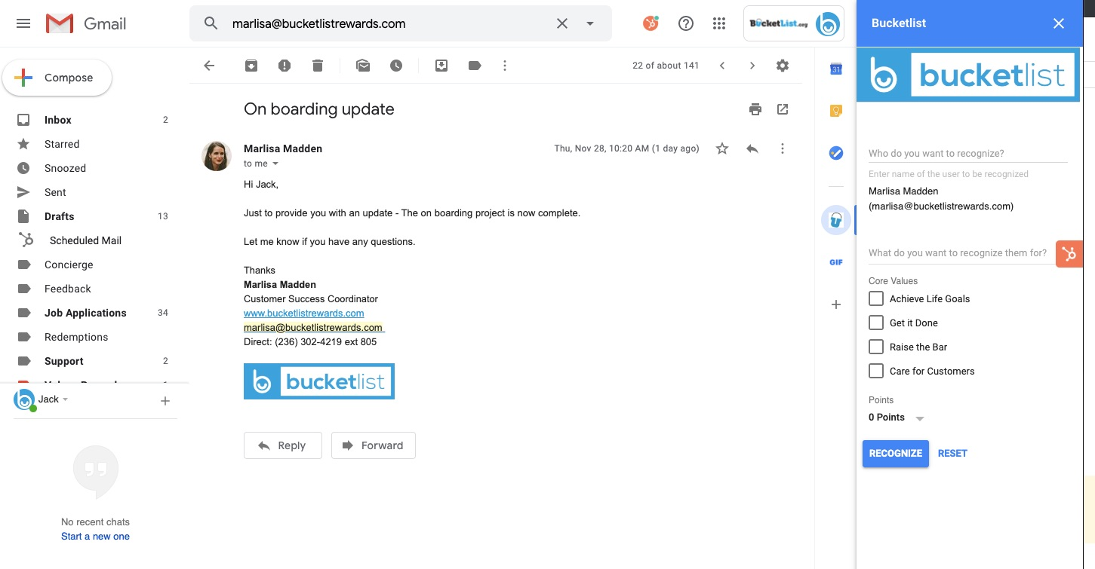
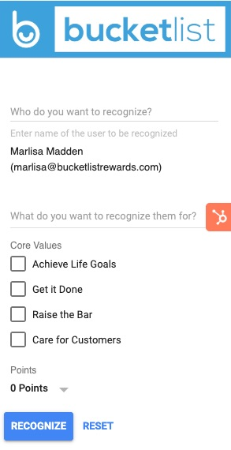
Gmail Integration
We integrate with Gmail making it easy for all employees to recognize one another

Slide 17
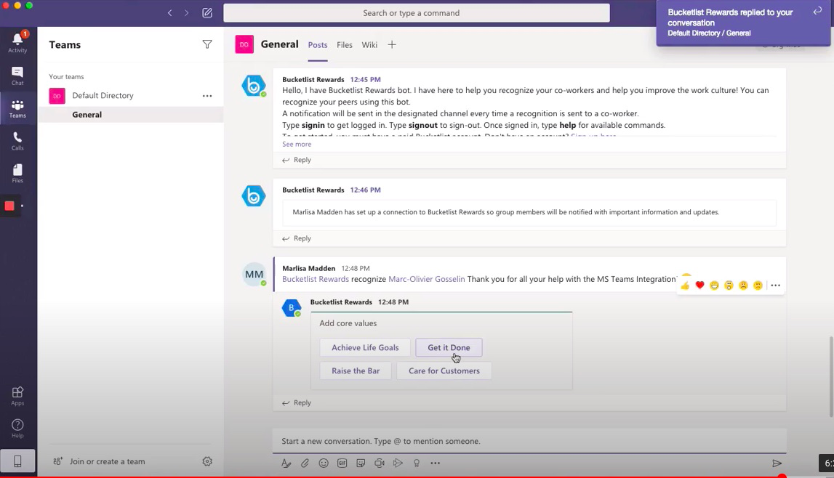
MS Teams Integration
We integrate with Teams making it easy for all employees to recognize one another

Slide 18
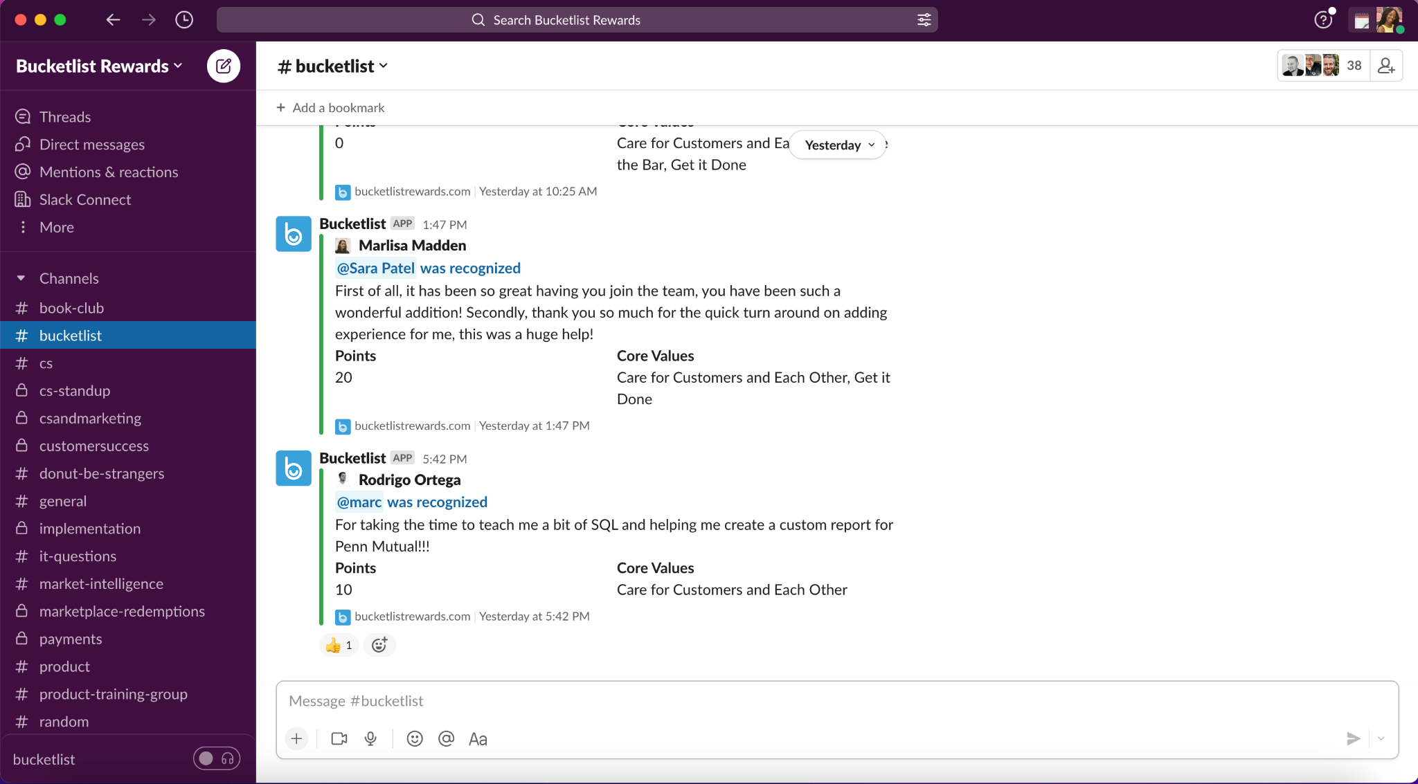
Slack Integration
Plus we have a great integration with Slack that is easy to add and even easier to use!
Our Slack recognition channel is: <ENTER CHANNEL NAME>
Notes:
Version 1 slack on a desktop
Pick between this version or the one below

Slide 19

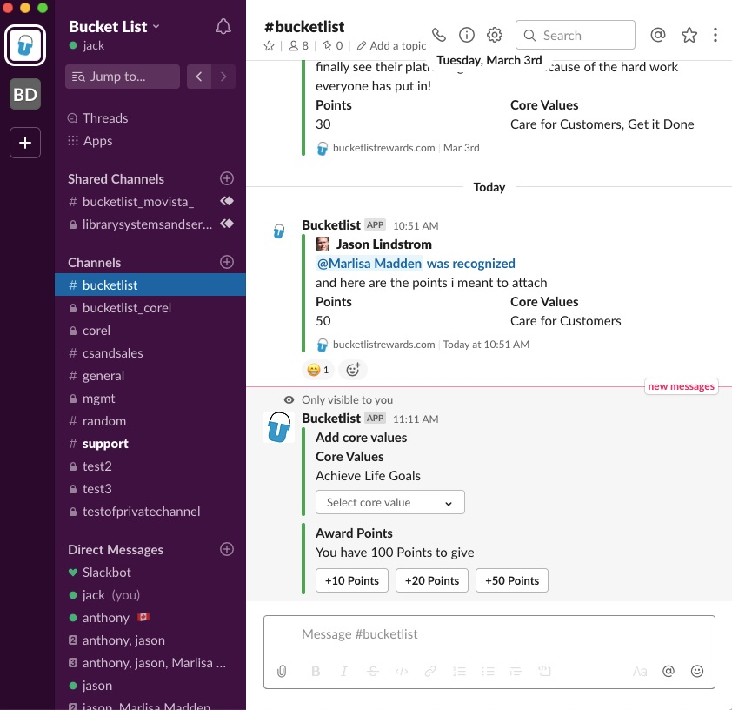


Slack Integration
Plus we have a great integration with Slack that is easy to add and even easier to use!
Our Slack recognition channel is: <ENTER CHANNEL NAME>
Notes:
Version 2 Slack mobile version

Slide 20
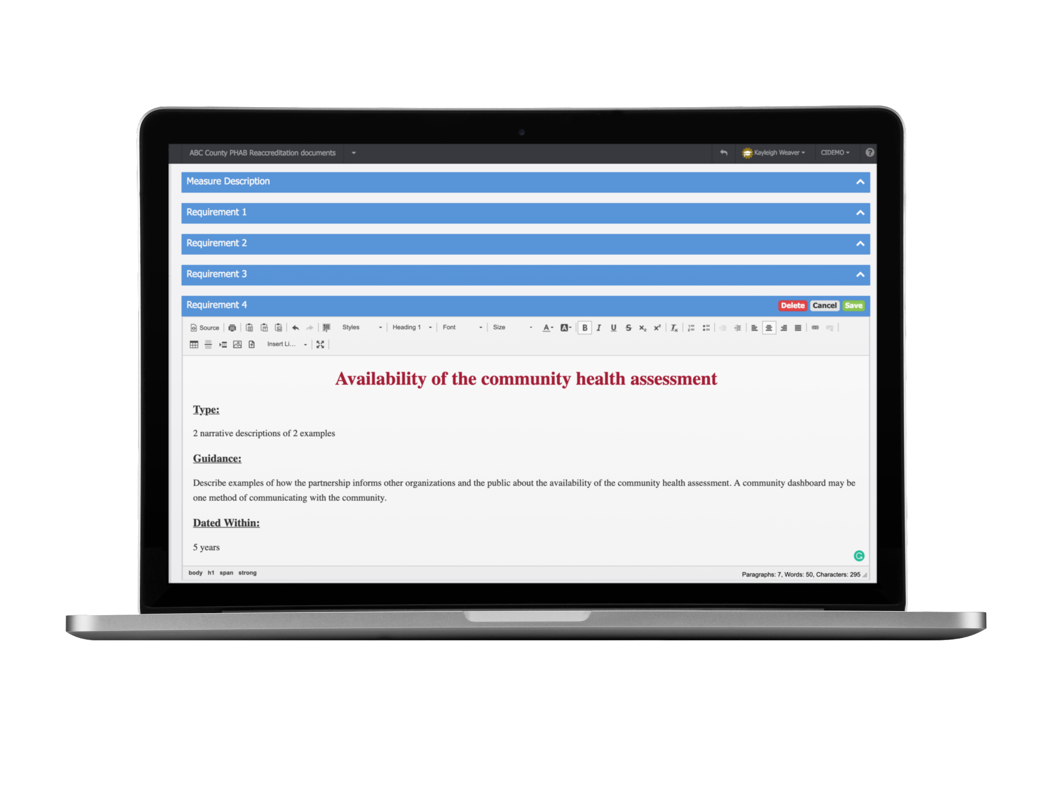
Bucketlist Demo

Slide 21




SPECIFIC
TIMELY
FREQUENT
CORE VALUE
How to make a recognition impactful
Make sure the recognition is given within a day of the good deed taking place
Ensure that recognitions are as clearly defined as possible.
Recognition should happen all the time. We recommend anywhere between a day and a week. Rotate between team members and departments.
Attach a core value to every recognition to keep them at the forefront of your employees minds

Slide 22
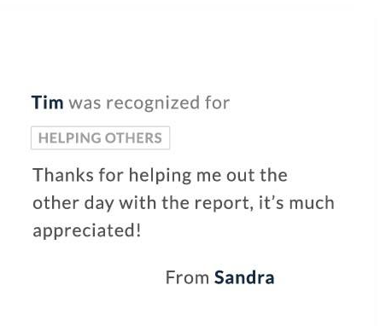
Incorporating recognition into your day to day
Add a “good news” section during your department, pre-shift or team meetings.
Pull up the activity feed. Call out great recognitions from the past week.
Have examples ready to “share stories of some outstanding contributions”.
Congratulate your team for their achievements & milestones when in conversation with each other.
Take it off line - start encouraging your peers!
Notes:
Manager training specific slide

Slide 23


Question &
Answer
Ongoing support: support@bucketlistrewards.com

Slide 24
Thank you!

