Slide 1

Bucketlist
Platform Training

Slide 2

Introduction
Bucketlist Demo
Bucketlist App
Integrations
Recognition Tips & Best Practices
Q&A
AGENDA
Notes:
Agenda with integrations

Slide 3
Introduction
Bucketlist Demo
Bucketlist App
Recognition Tips & Best Practices
Q&A
AGENDA
Notes:
Agenda without Integrations

Slide 4



What is
Bucketlist Rewards?
Seamless Recognition: Easily acknowledge and appreciate your team members in a meaningful manner.
Celebrate Milestones: Commemorate significant achievements and work milestones seamlessly.
Foster Company Culture: Nurture a strong culture by embodying core values.
Nurture Positivity: Promote a thriving workplace atmosphere.
Boost Team Engagement: Elevate team participation and commitment.
Notes:
Edit the points above to fit your company/platform setup. Below are additional points you can use instead of what is on the slide:
Rewards Points: Receive points and give out points with recognitions.
Redeem Rewards: Redeem your accumulated points for awesome rewards.

Slide 5


What is
an Ambassador?
You help drive success, engagement & product adoption of the program by encouraging others to participate and engage
You help educate and assist others with questions about the platform and program
You gather feedback and suggestions of how the platform and program can be improved
You demonstrate the purpose and value of recognition by regularly recognizing your peers
You celebrate the success of others by engaging on their recognitions and achievements

Slide 6



Why is recognition important?
76%
83%
88%
76% found peer praise very or extremely motivating
83% of respondents said recognition for contributions was more fulfilling than any rewards or gifts
88% found praise from managers very or extremely motivating
Study by Make Their Day (Psychology Today)
Notes:
Employee Training Slide
The fascinating findings of a study conducted by Make Their Day, as featured in Psychology Today. This study sheds light on the significant impact of recognition and praise on workplace motivation and morale.
Key Findings:
Peer Praise:
76% of participants reported that peer praise was very or extremely motivating.
Peer recognition fosters a sense of camaraderie and mutual appreciation among team members.
Recognition Over Rewards:
A staggering 83% of respondents expressed that recognition for their contributions was more fulfilling than any tangible rewards or gifts.
Unlike material incentives, recognition taps into the emotional aspect of motivation, driving a deeper sense of satisfaction and engagement.
Managerial Praise:
A striking 88% of participants found praise from managers to be very or extremely motivating.
The role of managerial recognition cannot be overstated, as it serves as a potent catalyst for employee morale and productivity.
Effective leadership involves acknowledging and appreciating the contributions of team members, thereby fostering a positive work culture.
Implications:
These findings underscore the importance of fostering a culture of recognition within organizations.
Implementing peer-to-peer recognition programs can harness the power of collective appreciation among colleagues.
Managers play a pivotal role in cultivating a supportive environment by consistently acknowledging the efforts of their team members.
By prioritizing recognition over material rewards, organizations can tap into intrinsic motivators, resulting in enhanced job satisfaction and performance.

Slide 7

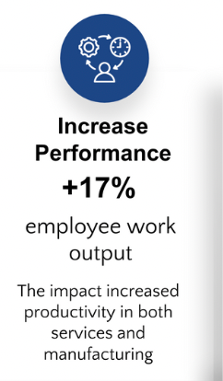
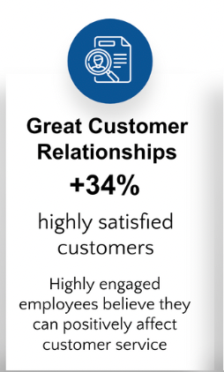
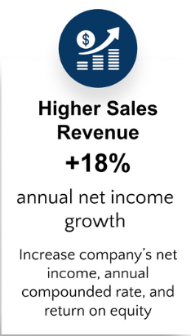
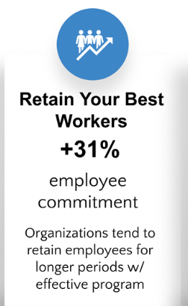
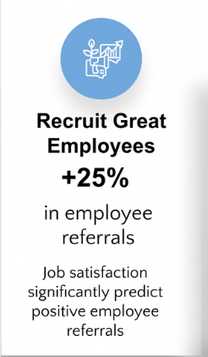
The ROI on Recognition
Notes:
Manager Training Slide
These results highlight the substantial Return on Investment (ROI) that recognition programs yield across various aspects of organizational performance:
1. Increase in Performance:
- Recognition leads to a notable 17% increase in employee work output, fostering higher productivity levels.
- This improvement is observed across both service and manufacturing sectors, indicating its universal applicability.
2. Enhancement of Customer Relationships:
- Recognition contributes to a remarkable 34% boost in customer satisfaction.
- Engaged employees, who feel valued through recognition, are more likely to positively impact customer service, nurturing stronger client relationships.
3. Revenue Growth:
- Companies experience an impressive 18% increase in annual net income as a result of recognition initiatives.
- This rise in net income, coupled with improvements in annual compound rate and return on equity, underscores the financial benefits of recognition programs.
4. Employee Retention:
- Recognition initiatives lead to a significant 31% increase in employee commitment.
- Organizations are better equipped to retain their top talent for longer durations through the implementation of effective recognition programs.
5. Recruitment of Top Talent:
- Recognition efforts result in a substantial 25% rise in employee referrals.
- Job satisfaction, driven by recognition, emerges as a key predictor of positive employee referrals, facilitating the recruitment of high-quality candidates.
In summary, these findings emphasize the multifaceted advantages of recognition programs, ranging from increased productivity and revenue growth to improved customer relationships and employee retention. Organizations that prioritize recognition initiatives stand to benefit not only financially but also in terms of cultivating a positive workplace culture and attracting top talent.
References:
Aktar, A., & Pangil, F. (2018). Mediating the role of organizational commitment in the relationship between human resource management practices and employee engagement: Does the black box stage exist? International Journal of Sociology and Social Policy, 38, 606-636.
Danish, R. Q., & Usman, A. (2010). Impact of rewards and recognition on job satisfaction and motivation: An empirical study from Pakistan. International Journal of Business and Management, 5(2), 159-167.
Ghosh, P., Rai, A., Chauhan, R., Baranwal, G., & Srivatav, D. (2015). Rewards and recognition to engage private bank employees: Exploring the “obligation dimension.” Management research review, 39(12), 1738-1751.
Grønholdt, L., & Martensen, A. (2019). Linking employee, customer, and business results: A study in the hotel industry. Total Quality Management & Business Excellence, 30(S1), S74-S82.
Harter, J. K., Schmidt, F. L., & Hayes, T.L. (2002). Business-unit-level relationship between employee satisfaction, employee engagement, and business outcomes: A meta-analysis. Journal of Applied Psychology, 87(2), 268-279.
Kerr, J., & Slocum, J. W. (1987). Managing corporate culture through reward systems. Academy of Management Executive, 1(2), 99-108.
Luthans, F., & Stajkovic, A. D. (1999). Reinforce for performance: The need to go beyond pay and even rewards. Academy of Management Executive, 13(2), 49-57.
Nelson, B. (1995). Motivating employees with informal awards. Management Accounting, 77(5), 30.
Seijts, G. H., & Crim, D. (2006). What engages employees the most or, the ten C’s of employee engagement. Ivey Business Journal, 70(4), 1-5.
Vance, R. J. (2006). Employee engagement and commitment: A guide to understanding, measuring, and increasing engagement in your organization. Effective Practice Guidelines. Alexandria, Va.: Society for Human Resource Management.
Van Hoye, G. (2013). Recruiting through employee referrals: An examination of employees’ motives. Human Performance, 26(5), 451-464.

Slide 8


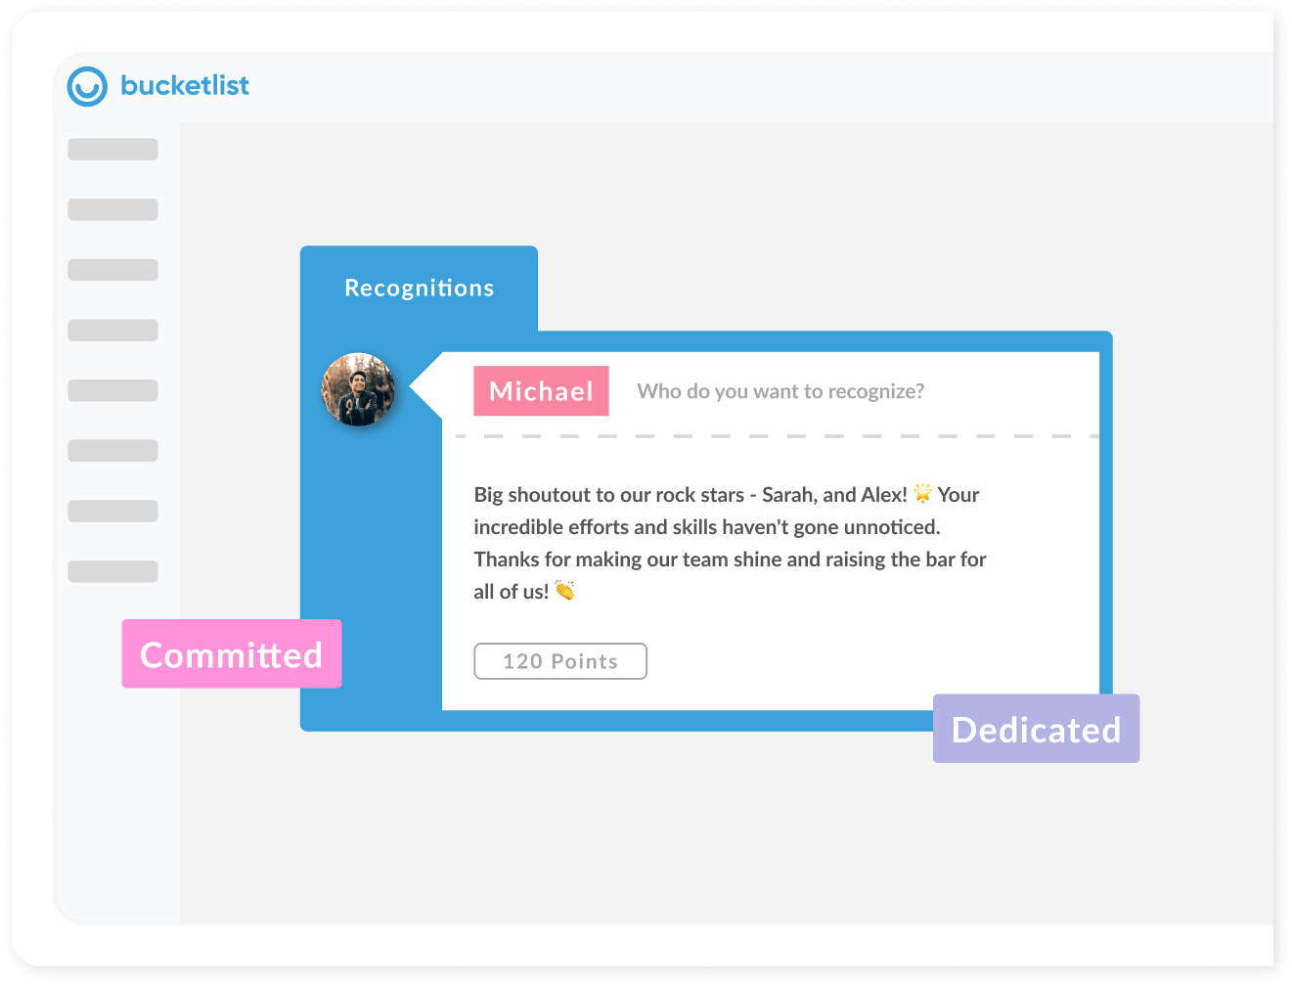
Bucketlist
Demo

Slide 9
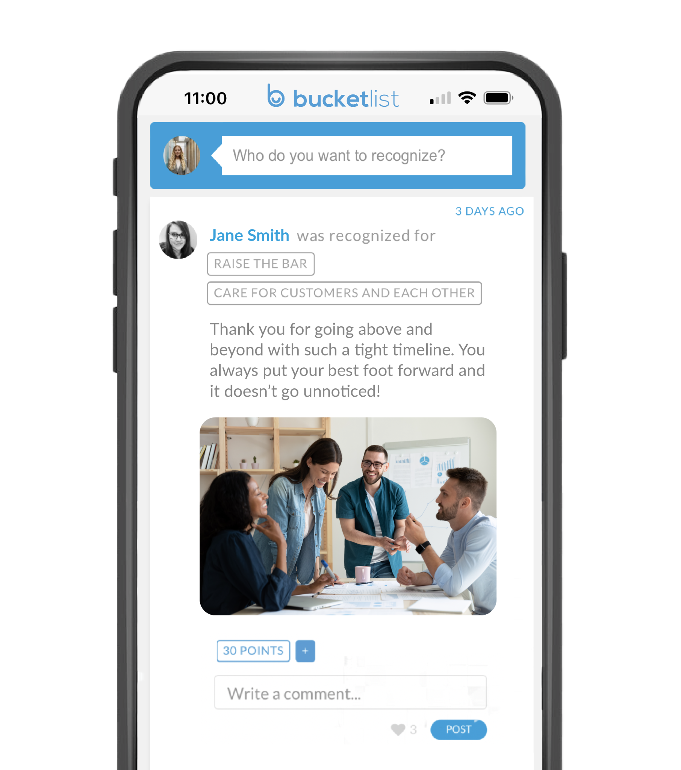


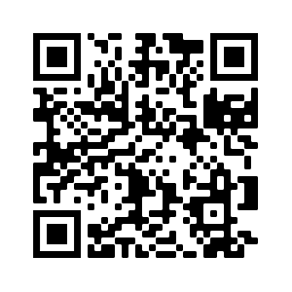
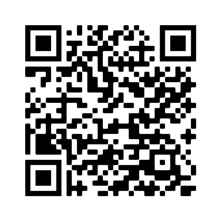
Bucketlist Rewards Mobile App
Easy & Convenient
Recognize staff for outstanding contributions straight from your phone
Like & Comment
Engage with your team by liking and commenting on posts

Slide 10

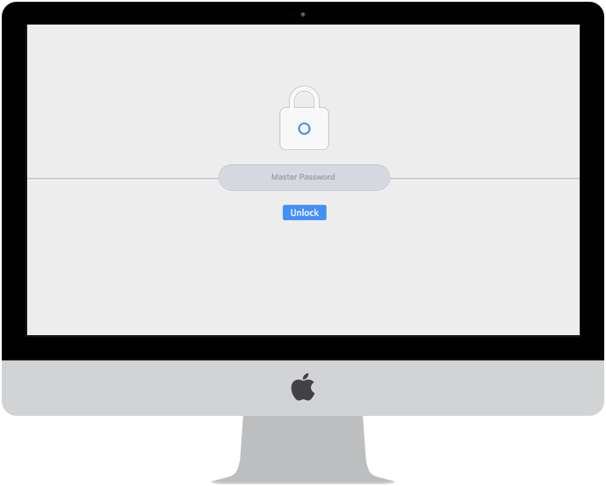
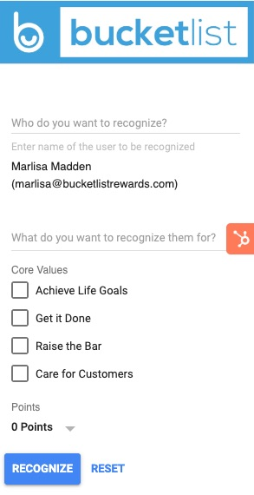
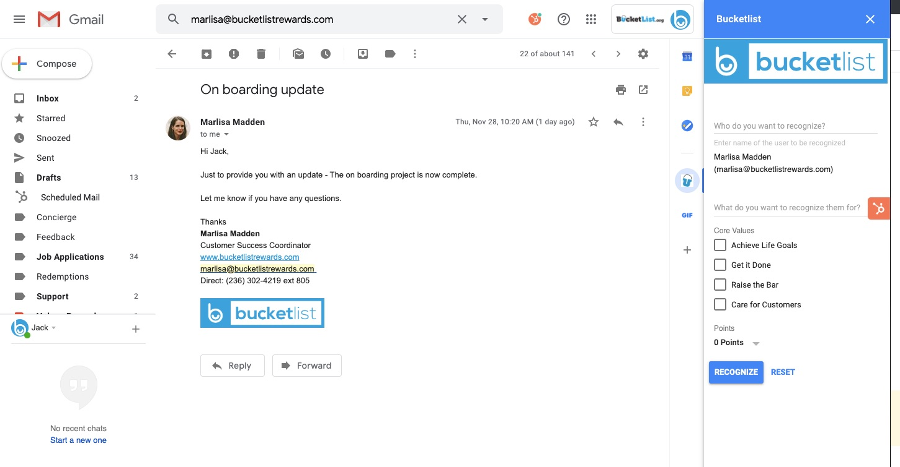

Gmail Integration
Check out the Gmail integration where you can recognize one another right from your email!

Slide 11
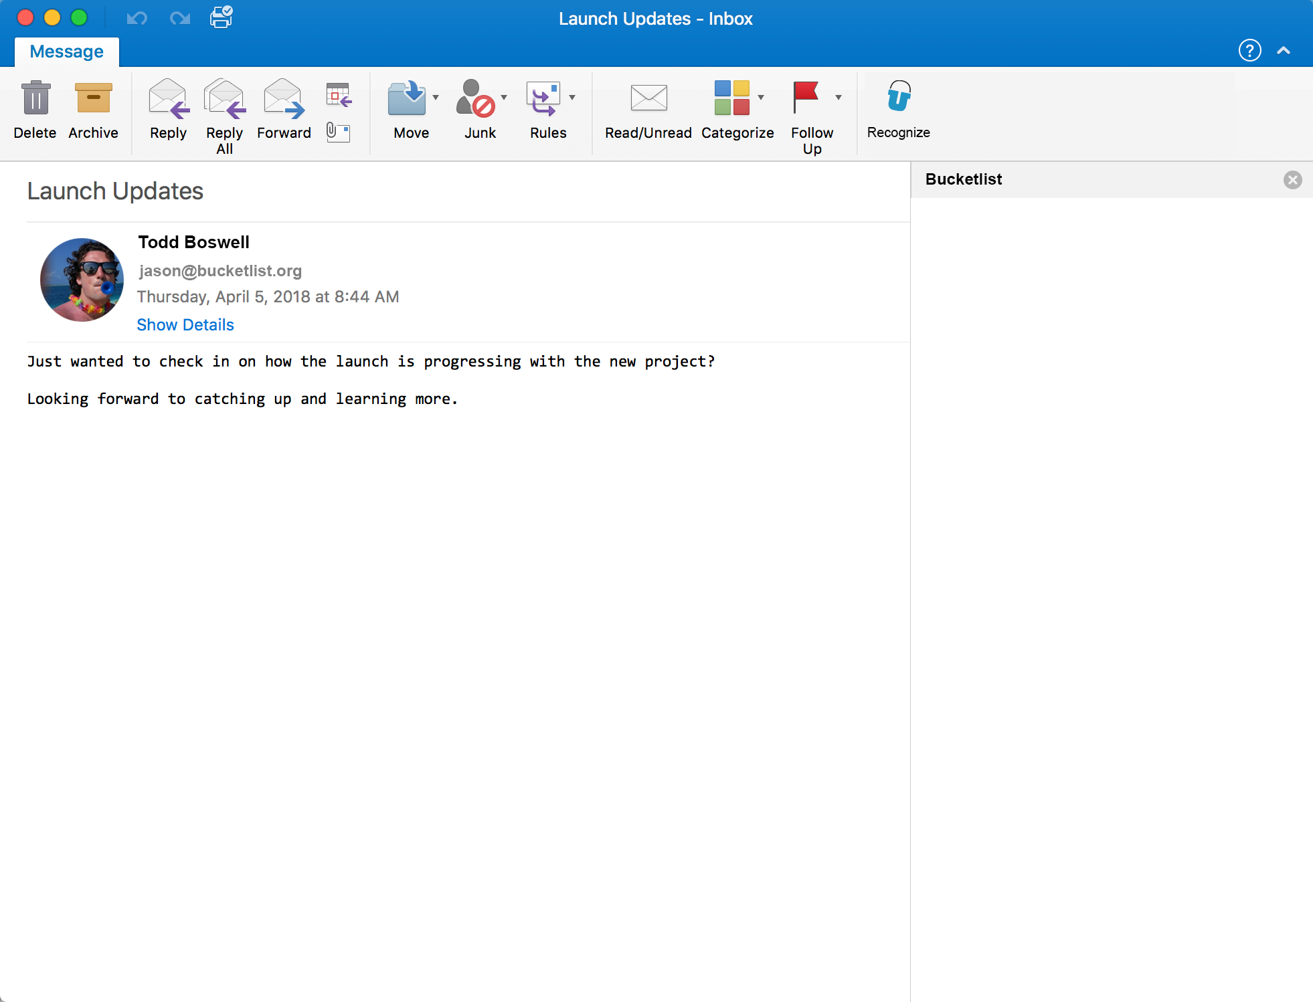
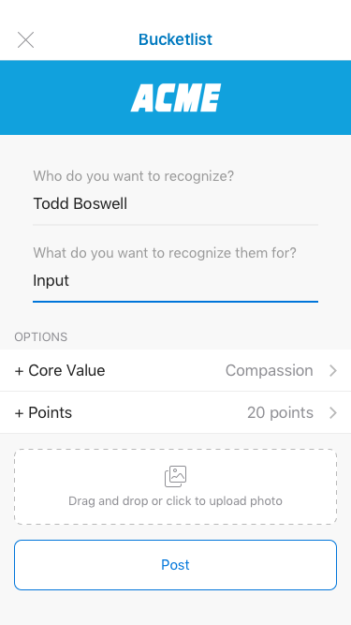

Outlook Integration
Check out the Outlook integration where you can recognize one another right from your email!

Slide 12
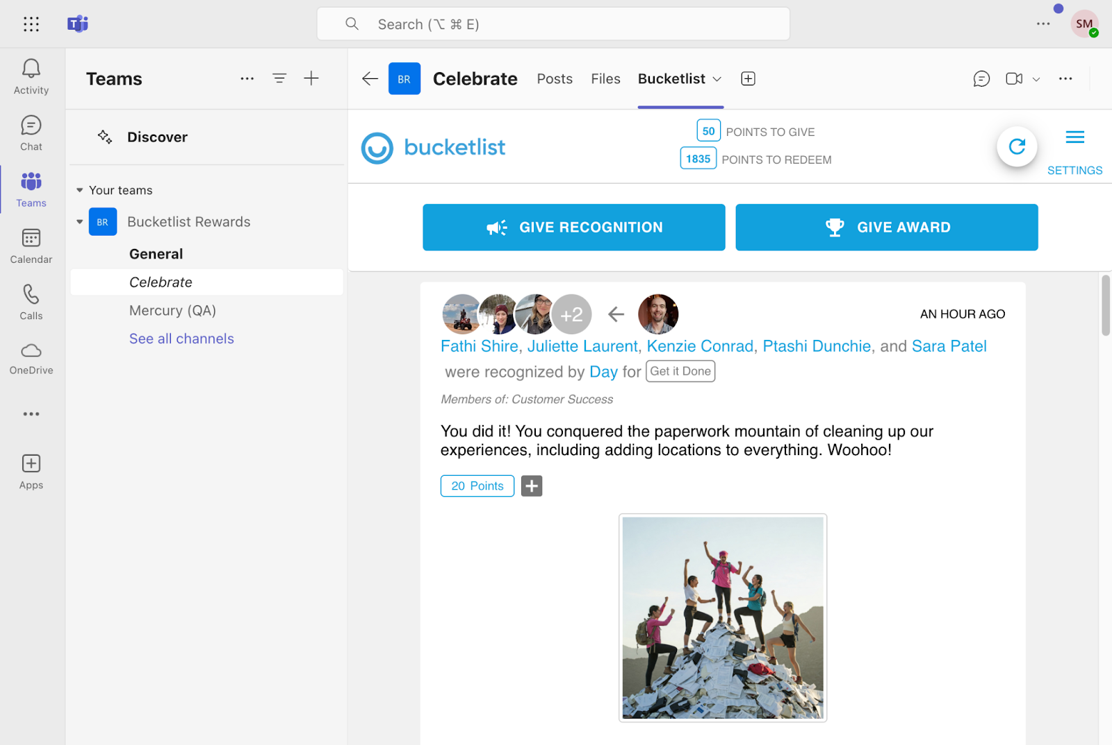

MS Teams Integration
MS Teams integration brings recognition into your daily workflows—making it easy to celebrate wins, boost engagement, and build culture by leveraging the tools your team already uses.

Slide 13
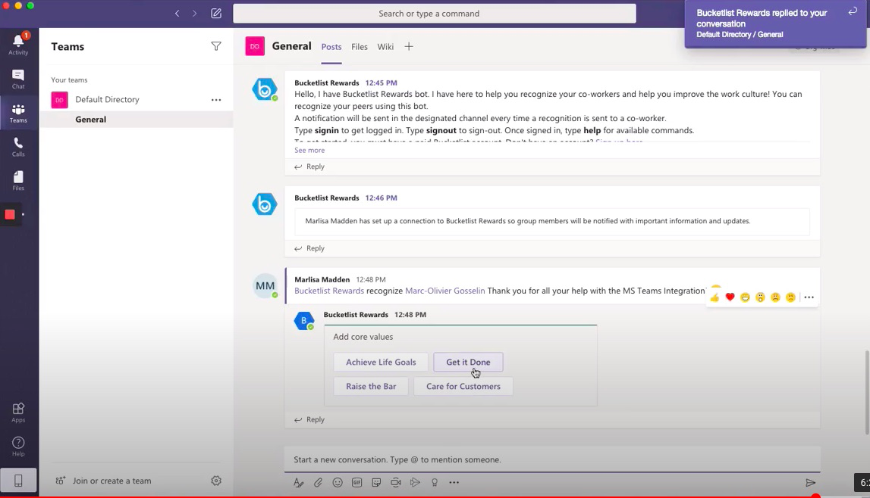

Slack Integration
Check out the Slack integration where you can recognize one another & read the Activity Feed!
Our Slack recognition channel name is <INSERT NAME>

Slide 14




Specific
Timely
Frequent
Core Value
Making recognition impactful
Make sure the recognition is given within a day of the good deed taking place
Tailor the recognition to the individual & be specific about what is being recognized
Don't limit recognition to major milestones. Consistently acknowledge small wins and efforts to create a culture of continuous appreciation. Rotate between team members and departments.
Attach a core value to every recognition to keep them at the forefront of your employees minds

Slide 15

How To Best Utilize Bucketlist
Engage on other recognitions
  Commenting and liking other recognitions helps show that you value and appreciate the contributions of your colleague
  This also helps reinforce the positive behaviour
Notes:
MANAGER TRAINING SLIDE

Slide 16
What can you recognize for?
Behaviours to recognize:
  Brainstorm what behaviours managers would recognize their staff for prior to the training session. Add those recognition ideas here and ask managers what they would recognize for during the call.
Notes:
MANAGER TRAINING SLIDE FOR ENGAGEMENT

Slide 17

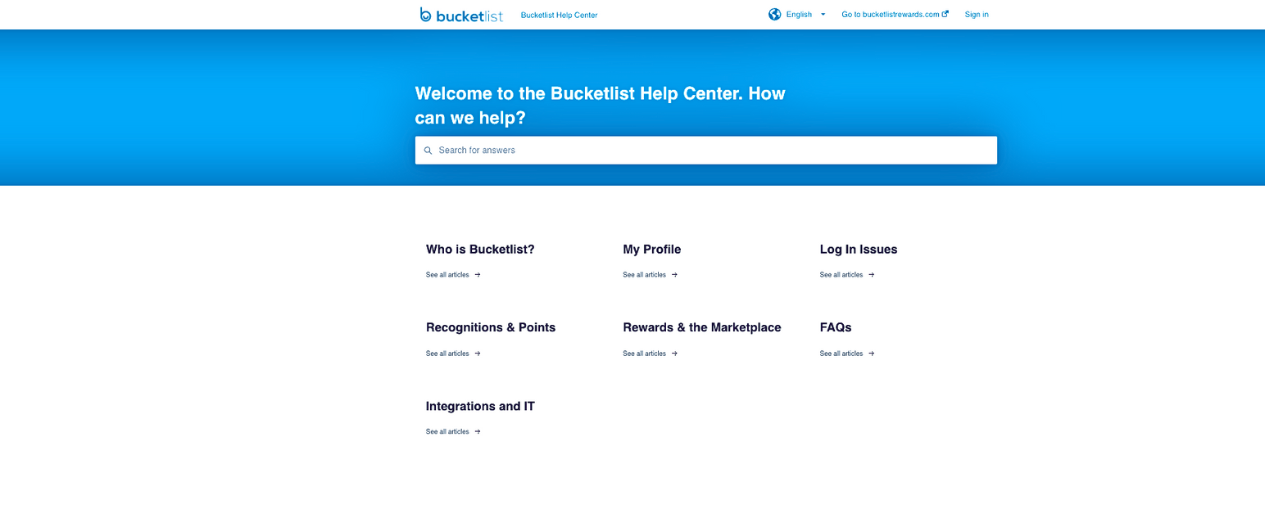


Bucketlist Help Center
Check out the Bucketlist Help Center, your go-to resource for answers to common platform-related questions.
Here you can easily find solutions to frequently asked questions like how to download the Bucketlist App, creating an account, and password resets.
support.bucketlistrewards.com
support@bucketlistrewards.com
Monday- Friday, 24 hour response time
Date / Speakers

Slide 18

Questions?
Notes:
https://support.bucketlistrewards.com/en/knowledge

Slide 19
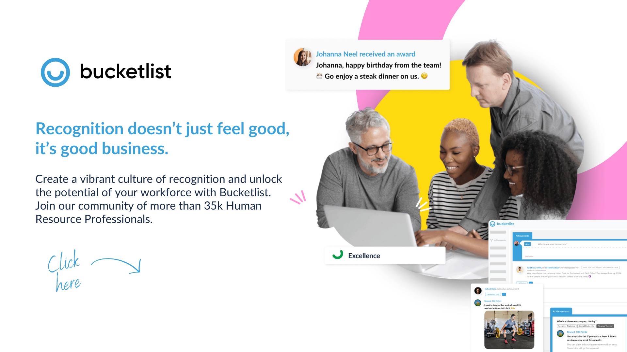




THANK YOU
www.bucketlistrewards.com | 1-800-338-9661

